Slide 1

MISSION
THAT LEADS TO GREATER WORKS.
John 14:12
Ptr. Rod Lago

Slide 2

I.ENGAGE YOURSELF

Slide 3
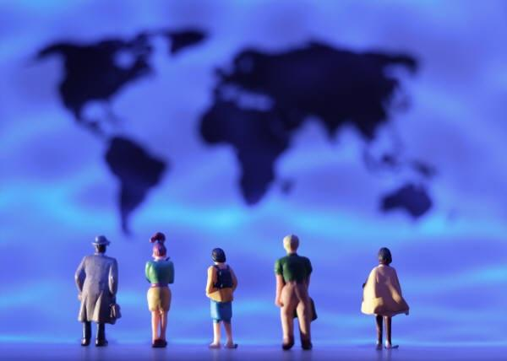
John 1:14
And the Word was made flesh and dwelt among us, we beheld his glory, the glory as of the only begotten of the Father, full of Grace and Truth.

Slide 4
Philippians 2:5-7
Let this mind be in you, which was also in Christ Jesus
Who being in the form of God, thought it not robbery to be equal with God.
But made himself reputation, and took upon him the form of a servant, and was made in the likeness of men.

Slide 5
When you Intentionally Engage yourself.
You will see the bigger picture of the Ministry.
You will feel and Experience the Deep Hurt of the Ministry.
You will experience the Ups and Downs of the Ministry

Slide 6
II. HAVE A SENSE OF URGENCY.

Slide 7
We must have sense of urgency in proclaiming the Gospel.
Because it is the Power of God that brings salvation to everyone who believes. Rom 1:16
b. Because it is the only way that all people will experience their Restoration, Healings, Signs and Wonders, Deliverance and Freedom.
Luke 4:18-19

Slide 8
2. HAVE SENSE OF URGENCY FOR THE LOST.
Harassed People – this are the kind of people that has no voice in their community Low Moral, No ability to Provide for their own needs. Rejected and Persecuted.
Hopeless People – this are the kind of people that are Helpless, Scattered, Faithless, Full of Fear and Discouraged.

Slide 9
III. TAKE RISK.

Slide 10
“If I will be given a chance to live again I will take bigger Risk and I will Dream Bigger Dreams”
– Tommy Barnett

Slide 11
IV. WE MUST DEPEND TO THE INDWELLING POWER OF THE HOLY SPIRIT.

Slide 12
*Apart from the Holy Spirit we cannot do anything.
* Growth is the Act of the Holy Spirit
*We must be saturated by the Holy Spirit

Slide 13
*We must be a Holy Spirit Driven Church
*If We will Depend on the Holy Spirit Power Nothing is Impossible

Slide 14
CONCLUSION…
IF WE WILL DO THIS…
1. To Engage Ourselves
2. To have a Sense of Urgency.
3. Willing to take Risk.
4. Depend to the Indwelling Power of the Holy Spirit.

